Slide 1

PROBABLITY RANDOM VARIABLES

Slide 2
Random Variables:
Random variables quantify outcomes of “random processes”-- map outcomes of these to numbers.
In simple words : A random variable is a variable whose value is unknown or a function that assigns values to each of an experiment's outcomes.
Denoted by capital letters usually.
Real-valued functions defined on the sample space

Slide 3
For Example :
“Sum” of the values on the two dice rather than the value of each die separately
Flipping a coin,
Rolling a dice
How much rain tomorrow

Slide 4
Types of Random Variables:
A random variable can be either discrete (having specific values) or continuous (any value in a continuous range).
Random variables are often used in econometric or regression analysis to determine statistical relationships among one another.

Slide 5
RANDOM VARIABLES
DISCRETE
RANDOM VARIABLES
CONTINUOUS
RANDOM VARIABLES

Slide 6
Example 1: Number of Items Sold (Discrete)
Example 2: Number of Customers (Discrete)
Example 3: Number of Defective Products (Discrete)
Example 4: Number of Traffic Accidents (Discrete)
Example 5: Number of Home Runs (Discrete)
Example 6: Marathon Time (Continuous)
Example 8: Animal Weight (Continuous)
Example 9: Plant Height (Continuous)
Example 10: Distance Traveled (Continuous)
Example 7: Interest Rate (Continuous)

Slide 7
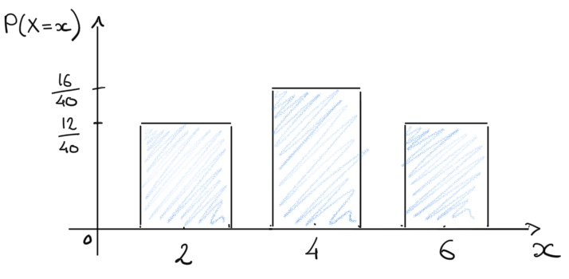
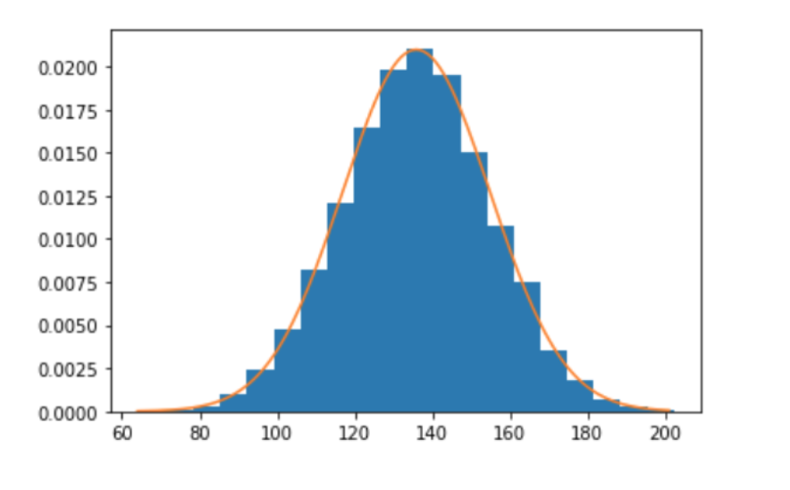
DISCRETE
RANDOM VARIABLE GRAPH
CONTINUOUS
RANDOM VARIABLE GRAPH

Slide 8
The use of random variables is most common in probability and statistics, where they are used to quantify outcomes of random occurrences.
Risk analysts use random variables to estimate the probability of an adverse event occurring.

Slide 9
EXPECTATION:
The expected value of a random variable is denoted by E[X].
The expected value can be thought of as the “average” value attained by the random variable.
The expected value of a random variable is also called its mean.
In which we use the notation µX. (µ is the Greek letter mu.) xP(X = x).

Slide 10
VARIANCE:
Variance is a measurement of the spread between numbers in a data set.
In particular, it measures the degree of dispersion of data around the sample's mean.
Investors use variance to see how much risk an investment carries and whether it will be profitable.
Variance is also used in finance to compare the relative performance of each asset in a portfolio to achieve the best asset allocation.
The square root of the variance is the standard deviation.

Slide 11
The Bernoulli Random Variables
Suppose that a trial, or an experiment, whose outcome can be classified as either a success or a failure is performed.
Let X = 1 when the outcome is a success and X = 0 when it is a failure, then the probability mass function of X is given by
p(1) = P{X = 1} = p
p(0) = P{X = 0} = 1 - p
where p, 0 ≤ p ≤ 1, is the probability that the trial is a success.
A random variable X is said to be a Bernoulli random variable (after the Swiss mathematician James Bernoulli) if its probability mass function is given by the above equations for some p ∊ (0, 1).
A Bernoulli random variable is said to have a Bernoulli distribution.

Slide 12
The Bernoulli Random Variables
Example:
Only one flip of a coin toss. Here, if p is the probability of a head
occurring, 1-p is the probability of a tail occurring, since head and tail
are the only two events that can occur.
We can consider either event as a success and the remaining event as
a failure.

Slide 13
The Bernoulli Random Variables
Real world examples can be of:
In finding defective items, the outcome could be either success (item is defective) or failure (item is non-defective).
Operation done by a doctor to a patient.(Can be a success if he get cured or failure when he dies).

Slide 14
– Example 1
Tossing a coin can result in only two possible outcomes (head or tail). We call one of these outcomes (head) a success and the other (tail), a failure.
The probability of success (p) or head is 0.5 for a fair coin. The probability of failure (q) or tail = 1-p = 1-0.5 = 0.5.
If we denote head as 1 and tail as 0, we can plot this Bernoulli distribution as follows:
We have two outcomes:
Tail or 0 with a probability of 0.5.
Head or 1 with a probability of 0.5 also.

Slide 15
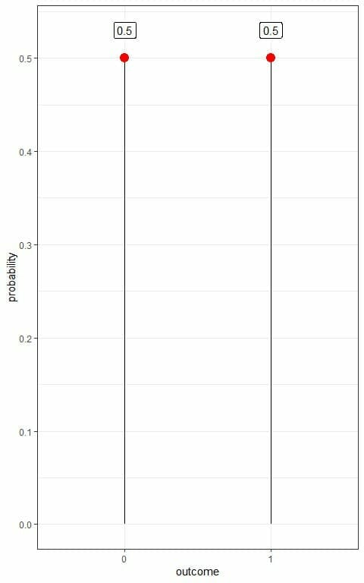
This is also an example of
a probability mass function
where we have the probability
for each outcome.

Slide 16
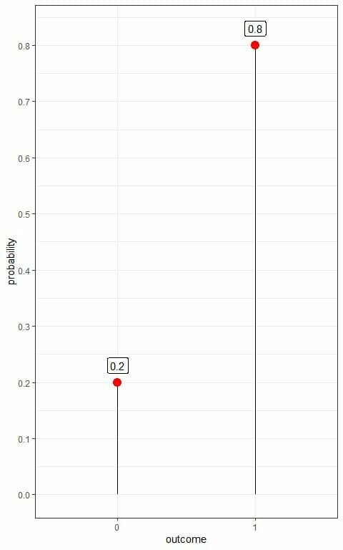
– Example 2
We have an unfair coin where the probability of success (p) or head is 0.8 and the probability of failure (q) or tail = 1-p = 1-0.8 = 0.2.
If we denote head as 1 and tail as 0,
we can plot this Bernoulli distribution
as follows:
We have two outcomes:
Tail or 0 with a probability of 0.2.
Head or 1 with a probability of 0.8.

Slide 17
THANK YOU… By K Akanksha Raju.

